Slide 1

Lecture 5: Service
Topics: Services, Broadcast Receiver, Playing Media

Slide 2
Today’s class:
Concepts
(Lecture)
What is a Service?
Types, ways to interact.
Questions
(code)
How do we create + start a service?
Example PrimalityTest service.
Concepts
(lecture)
How do we play music in Android?
Sync, Async, and Service!
Example
(code)
Create a music player.
Use Async prepare and a service.

Slide 3
Concepts

Slide 4
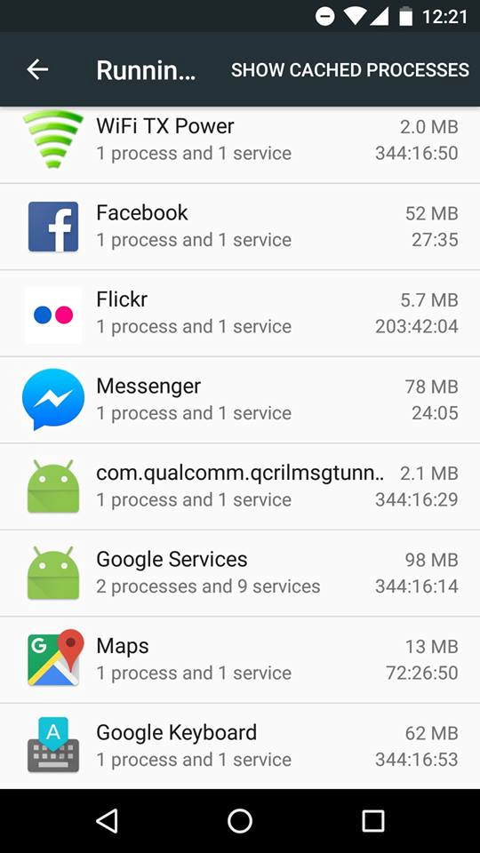
Service
A UI less component that runs in the background to perform (long-running) operations.
Example: Sensors, location, power, battery, etc.
Settings>Developer Options>Running Services
Notes:
Power manage: wake lock, reboot.

Slide 5





Custom Service
We can create our own service.
See any commonality?
Notes:
Power manage: wake lock, reboot.

Slide 6

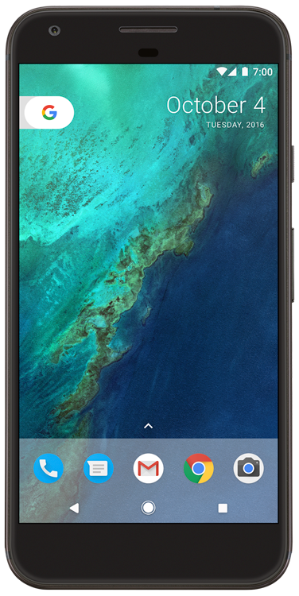

Types of Services
Foreground and Background Services
Foreground
Service
Background
Service
noticeable to users
must show notification
not noticeable to users
only foreground apps can start

Slide 7
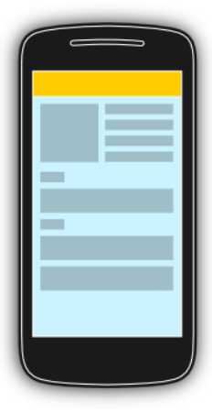
Types of Services
Bounded and Unbounded Services
bindService()
Request/Response
Bound Service
(dies when #clients = 0)
Client
(e.g. an activity)
Notes:
Power manage: wake lock, reboot.

Slide 8
Types of Services
Bounded and Unbounded Services
startService()
broadcasts
Unbounded Service
(stopped explicitly)
Client
(e.g. an activity)
Notes:
Power manage: wake lock, reboot.

Slide 9
Service Runs In …
Services run in the main thread of its hosting process.
start
start
T2
T1
T1
Default
What You Should Do
Notes:
Power manage: wake lock, reboot.

Slide 10
Question #1
How do you create a Custom Service?

Slide 11
Question #2
How do you start a Service?

Slide 12
Creating a Custom Service
Extend a service and override some callbacks.
Caution: Don’t forget to declare it in the manifest.
Custom Service:
extends Service/IntentService
onCreate()
startService()
onStartCommand()
Component X:
bindService()
onBind()
Component Y:
onDestroy()
Notes:
Similar to CustomView, but …

Slide 13
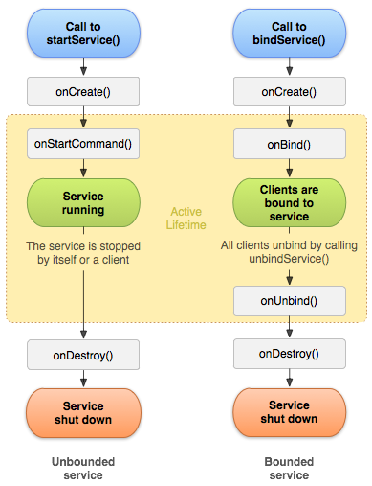
Service Lifecycle
Two execution paths for startService() and bindService():
Q. Who stops a Service?
Notes:
Power manage: wake lock, reboot.

Slide 14
Coding Example
Create a custom service by extending Service that tests primality of a number.
Use Intents to illustrate that it works.
How do we get results back?
Activity
Service
startService(Intent)
Notification,
Toast
Broadcast
Receiver
sendBroadcast(Intent)

Slide 15
Playing Media

Slide 16
Media Playback
Play Audio/Video from:
Application Resources (raw resource)
File System
Data Stream over a Network.
Support for Output Devices:
Speaker
Bluetooth Headset
However, you cannot play sound files in the conversation audio during a phone call.

Slide 17
Media Playback API
Two important classes –
MediaPlayer
stop, play, pause …
AudioManager
volume, ringer mode (mute, vibrate) …

Slide 18
Using Media Player API
Permissions: INTERNET, WAKE_LOCK, STORAGE
Playing from Local Resource:
Playing from a Local Uri:

Slide 19
Using Media Player API
Playing from an Internet URL
Must be progressively downloadable
Supported media format:
http://developer.android.com/guide/appendix/media-formats.html

Slide 20
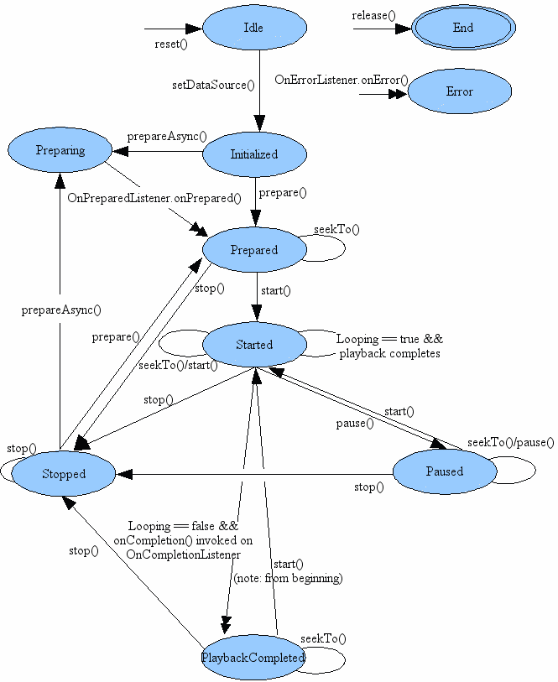
Media Player State Diagram

Slide 21
Asynchronous Preparation
For files:
It is “OK” to use prepare()
For streams:
You should always use prepareAsync()
Implement MediaPlayer.OnPreparedListener
mp.setOnPreparedListener(this);
public void onPrepared(MediaPlayer mp)
{
mp.start();
}
BLOCKING
NON-
BLOCKING

Slide 22
Using Wake Locks
When device sleeps, the system tries to shut off features that are not necessary – including CPU and WiFi hardware.
Use “Wake Locks” to let the system know you need some features even if the phone is idle.
mp.setWakeMode(getApplicationContext(),
PowerManager.PARTIAL_WAKE_LOCK);
WifiManager.WifiLock wifiLock =
((WifiManager) getSystemService(Context.WIFI_SERVICE)) .createWifiLock(WifiManager.WIFI_MODE_FULL, "mylock"); wifiLock.acquire();

Slide 23
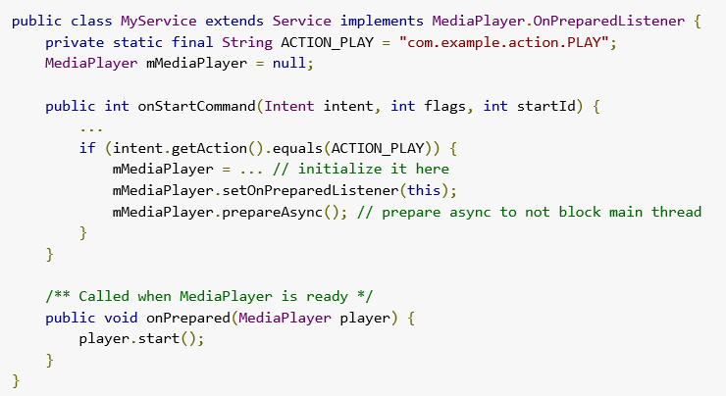
Playing songs in a background service

Slide 24
Code practice
Create a MediaPlayer and play a song.
Modify the code to prepare a media player asynchronously.

Slide 25
References (study these)
https://developer.android.com/guide/components/services.html
http://developer.android.com/guide/topics/media/mediaplayer.html
http://developer.android.com/images/mediaplayer_state_diagram.gif

